Slide 1
(user) authentication

Slide 2
User authentication
Prove you are really the one you claim to be
Do not confuse:
Identification → show your «digital identity» (email, ID)
Authentication → prove your digital identity is controlled by you (e.g. you know a secret password)
Actually, not so simple…
There might be no requirement to link identifier to a real-life identity
Successful authentication = I’m reasonably assured that the subject accessing the service today is the same as the one which accessed the service in the past.
NIST SP 800-63-3 definition for digital user authentication: the process of establishing confidence in user identities that are presented electronically to an information system

Slide 3
Authentication Means
Something you (and only you) know
Password, PIN, secret key, answer to a pre-arranged question, …
Something you (and only you) have
Smart card, Physical devices (tokens)
Very interesting area: “authentication” based on HW uniqueness → PUF (Physically Unclonable Function)
Something you are (static biometrics)
retina, fingerprint, face, …
Privacy? And what about DNA (Remember Gattaca?)?
Something you do (dynamic biometrics a.k.a. behavioral authentication)
Voice recognition, hand writing, typing characteristics
… even Mouse Movements!!
But there are also other specific means harder to classify, e.g. location-based auth

Slide 4
Authentication: “proof of…”
To “prove” I know a password does NOT necessarily imply revealing it
Though revealing the password is ONE POSSIBLE approach
Passwd Authentication Protocol - PAP
Different techniques → different levels of information disclosure
PAP = full disclosure
CHAP = some information leaks
ZKP = no information leakage

Slide 5

User authentication – recap: Password Authentication protocol
Prove you know your password by… showing it in clear!
User
Authenticator
User_ID: GB
Passwd: pippo
{GB, pippo}
User Database
UID PW
…
…
OK, you’re in!
GB
pippo
…
…

Slide 6
User authentication – recap: Challenge-Handshake Auth Protocol (CHAP)
Prove you know your password by… sending the result of a secure computation!
(usually hash function but not necessarily – more later)
2) UID, RES = SECURE_FUNCTION(Challenge, Pw, etc)
Authenticator
Remote User
User Database
1) Challenge
…
…
UID
pass
…
…
RES=XRES??
3) Success, Failure
XRES=F(Challenge, pass, etc)
Secret passwd never transmitted in clear - Hash is the usual approach, but it is NOT the only one
Other common approach: encrypt challenge using P as secret key. But requires more care! More later.

Slide 7
Remark: Password or secret key?
Authentication
Prove I know a password or a secret
Passwd or secret? conceptually the same
A password is (should be) a secret
Practically there is a HUGE difference
Secret ley: a random string of N bit
Probability to guess it = 1 out of 2^{N}
Password: a low-entropy string!!
Probability to guess it: MUUUUCH lower than n = 1 out of 2^{N}

Slide 8
What is best? CHAP or PAP?
Correct answer: DEPENDS!!!
(depends on what? On the attacker’s model)

Slide 9

2 main (*) attack models
Communication channel
UID - passwd
database
Attack to the communication channel
Eavesdropper, MITM, replay, …
Game Over!
If you want to use PAP, you MUST protect communication channel
E.g. online login via https, EAP-TTLS, etc
Attack to the backend UID-passwd database
Attacker penetrates system and steals entire passwd DB
Mitigation: hashed password database!
(*) other system-level attacks: insiders, workstation hijacking, key loggers, fake screens, etc

Slide 10
Hashed passwd database in PAP
Idea: store H(passwd) instead of passwd
Improved security: if attacker steals DB, still has to «invert» passwd
Good hash = one-way → only method is brute-force/guess
Security ultimately depends on choosing «strong» passwd
Authenticator
User
Compute α=H(pippo)
User_ID: GB
Passwd: pippo
Retrieve β
{GB, pippo}
check α=β?
OK
… … …
GB→β=H(pippo)
… … …

Slide 11
(actually: «salted» hash)
User | Salt | Hashed passwd = H(salt, passwd)
Giuseppe | a31 | d8578edf8458ce06fbc5bb76a58c5ca4
Letizia | 117 | a00e014ec1a1148986e05d0c151b92c4
Ciro | 1e8 | f1ce609eb6591ecd3dc405282fef22f9
Jasmine | f7d | 5b4805eae94d66c1a422189a53f9f06a
… … … |  | … … … … … … … … … … … … … … …
Security: same as hashed passwd
Salt in clear: not nearly an issue for crypto hash!
advantages
Harder to crack against rainbow tables! (need one table per each salt value)
12 bit salt = 2¹² tables, huge memory requirements!
Same passwd but different salt → different hash
Attacker cannot see if passwd is reused – two cases
Inside DB: same passwd among different users
Across DBs: passwd reused by same user

Slide 12
Autentication using salt
Authenticator
User
Lookup GB
User_ID: GB
Passwd: pippo
Retrieve salt
{GB, pippo}
Compute α=H(71,pippo)
OK
check α=β?
User-side: no changes!
… … …
GB, 71, β=H(71,pippo)
… … …

Slide 13

And what about CHAP?
CHALLENGE = 135623
RESPONSE = Flavia, H(mypass | 135623)
User Database
…
…
ACK or NACK
flavia
mypass
…
…
No way to compute H(pw, challenge) without having pw in clear!
Consequence: user DB must remain in clear → straightforward target for attack!
Conclusion: CHAP is worse than PAP against a backend attack model!!

Slide 14
Take home: it all depends on attacker’s model!
In security there is NO «best» algorithm
Solutions must be adapted to threat model
If Attacker = eavesdropper, then CHAP better
But if Attacker = backend, then PAP better!
Hence there is not a «single» solution, but all depends on which attack you aim at defending

Slide 15
CHAP Mitigation: (explicit) “salt”
CHALLENGE = 135623; SALT = 9876
RESPONSE = Flavia, H(H(9876,mypass) | 135623)
ACK or NACK
User Database: SALT=9876
Same idea as «usual» salt
Salt value is in clear
Store H(salt, passwd)
very different reason and use!
Attacker cannot anymore «reuse» stolen passwd!
But of course passwd strength and dictionary attacks still hold…
After a breach (or periodically), regenerate entire DB using new salt
…
…
flavia
H(9876,mypass)
…
…

Slide 16

Hashed passwd: which hash?
Best crypto hash today: SHA256
Seems very good idea to use it…
Sure???
Why warning?

Slide 17

Hashed passwd again: which hash?
SHA256: 2 problems!
1. Designed to be fast
Fast computation = faster cracking!
2. Used in Bitcoin mining
Today: specialized and cheap ultra-high performance HW for SHA256 computation!
SHA256 hash rates
PC: core i7 3930k
66.6 MH/s (~190watts)
Hardware (e.g. Antminer): @ July 2023:
Bitmain AntMiner S19j pro: 118 TH/s (~3 kW, 2259 EUR)
Bitmain AntMiner S19j XP: 151 TH/s (~3 kW, 3999 EUR)
0.93 seconds average time to brute force 8 bytes truly random base64 charset passwd!
About 22 seconds for 8B passwd using all the keyboard chars/symbols

Slide 18
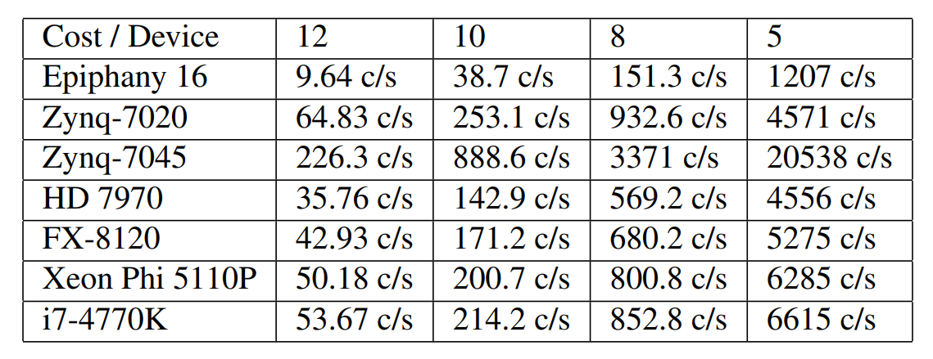
Hashed passwd: best with slow hash!
Bcrypt: designed in 1999 for unix (OpenBSD) systems
SPECIFICALLY (!) for password hashing
Includes salt + «cost» parameter
Cost = x → requires 2^{x} iterations - example:
cost = 10 → o(1000) iterations per hash
Cost = 13 → o(10.000) iterations
Performance
From: 2014, https://www.usenix.org/system/files/conference/woot14/woot14-malvoni.pdf

Slide 19
Take home
Again!
Your choice depends on the attacker model!!
Attacker model against hashed passwd DB?
Brute force, dictionary
But hash functions designed for something else!
collision resistance, pseudorandomness
So? The stronger and best hash for us is a SLOW one!
Use a programmatically SLOW hash functions, e.g. classic Unix’ BCRYPT
Include a cost parameter!!
cost = 10 → o(1000) iterations per hash
Cost = 13 → o(10.000) iterations
Newer passwd-specific hash constructions: Argon2, PBKDF2, etc

Slide 20
Mutual Authentication with CHAP Take home of this lecture (again): Don’t use crypto algorithms for a different scope (even if a slightly different one!), or with different assumptions

Slide 21
CHAP
CHALLENGE = 135623
RESPONSE = Flavia, H(mypass | 135623)
ACK or NACK
User Database
…
…
flavia
mypass
…
…

Slide 22
CHAP and mutual authentication /1
CHALLENGE = 135623
RESP: Flavia, H(sharedsecret, 135623)
ACK
CHALLENGE = 324567
Usage of a shared
Secret… good idea,
Easy to manage!
Good idea??
RESP: servername, H(sharedsecret, 324567)
ACK

Slide 23

CHAP and mutual authentication /2 Reflection attack in PPP order of messages does not count
CHALLENGE = 135623
CHALLENGE = 135623
RESP: servername, H(sharedsecret, 135623)
VERY risky!!.
Attacker:
replays server challenge
accept computed resp
uses resp to authenticate!!
Without any info on
real client !!
ACK
RESP: client, H(sharedsecret, 135623)
ACK

Slide 24
Yes but this happened because you used two unilateral authentication protocols! Let’s combine them into a single Mutual authentication with Challenge-Response

Slide 25
Pippo’s mutual authentication protocol (seriously, don’t do this!)
Boss, C1
C2!=C1
Flavia, C2, H(secret, C1)
C1!=C2
Boss, H(secret, C2)
Flavia shows knowledge of secret over C1
Boss shows knowledge of secret over C2!=C1
Where is the flaw?

Slide 26

Reflection! Again!
Boss, C1
C2!=C1
Flavia, C2, H(secret, C1)
C1!=C2
Boss, C2
Flavia, C3, H(secret, C2)
Boss, H(secret, C2)

Slide 27
What if reflection is prevented by protocol status?
Attacker may use “other” party!
Intertwining attack
Boss, C1
Flavia, C2, H(secret, C1)
Flavia, C2
Boss, C3, H(secret, C2)
Boss, H(secret, C2)

Slide 28
Let’s try to fix this
Boss, C1
Flavia, C2, H(secret, C1, C2)
Boss, C3, H(secret, C2, C3)
Chaining challenges! Add dependency
between challenges in same handshake

Slide 29
Does not work
Boss, C1
Flavia, C2, H(secret, C1, C2)
Boss, C2
Flavia, C3, H(secret, C2, C3)
Boss, C3, H(secret, C2, C3)
Too many nonces!!

Slide 30
But if we minimize nonces…
Boss, C1
Flavia, C2, H(secret, C1, C2)
Same challenges, but different values (order!)
Boss, H(secret, C2, C1)
No reflection possible anymore

